Slide 1
Meal Recognition
Team Member:
Kai Wu
Rundong Zhao
Ze Zhang

Slide 2
Introduction
Meal recognition technology becomes an important research topic because of its wide applications in other research fields, such as nutriology.
SIFT (Scale-Invariant Feature Transform), Bag of Words and Neural Network are used in our project.

Slide 3
Algorithm
System procedure
Extract Features
SIFT
Quantization
BoW
Classification
Neural network

Slide 4
SIFT
SIFT feature is a 128 dimension vector, which we can view as a point in 128 dimension space.
For a certain image, after applying the SIFT algorithm, we can get several SIFT features for this image.
Note that different image may have different number of SIFT features.

Slide 5
Bag of Words
Collect all the SIFT features of all the images. Now we get many points in the 128 dimension space.
We do a k-means clustering to all the points, and get k centers.
k is specified by the user, and we select appropriate k value to make the result better.

Slide 6
Bag of Words
For each of the images, we calculate how many feature points belongs to each of the cluster centers.
We get a k dimensional vector for each of the image.
We normalize the vectors.
Now we have a normalized vector acting as a feature vector for each of the images.

Slide 7
Neural Network
Now we have the dataset
image 1: v_1 ,1
image 2: v_2, 1
....
image n: v_n, 10
The vector is the feature vector for the image, the index represents the meal type.
Use the neural network tool in matlab to train the data set.

Slide 8
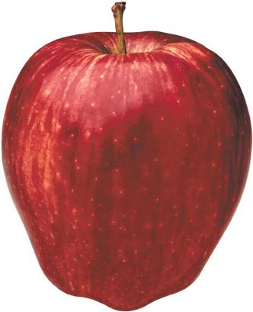
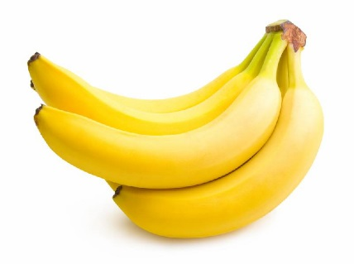
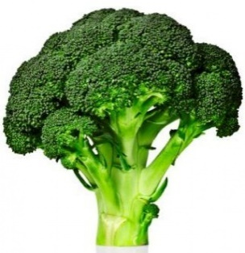
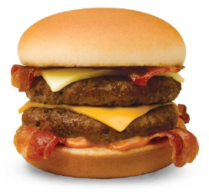
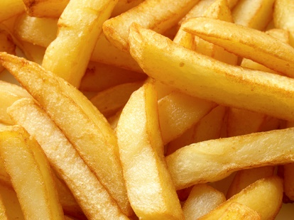
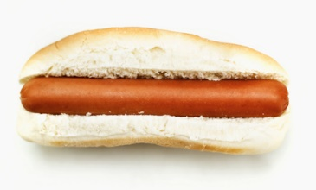
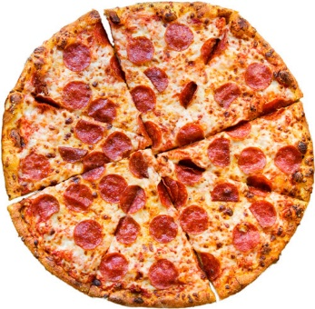
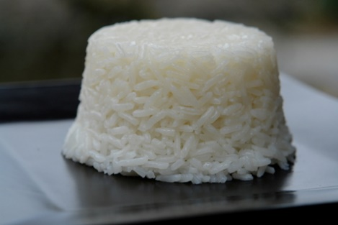
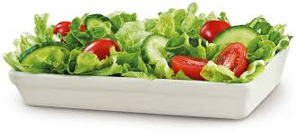
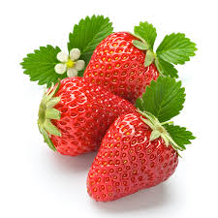
Data Collection
We collected 10 classes of images from google image, about 60 training images per class.

Slide 9
Training Result
Apple | Banana | Broccoli | Burger | Fries | hotdog | pizza | Rice | Salad | Strawberry
0.79 | 0.86 | 0.95 | 0.74 | 0.87 | 0.74 | 0.78 | 0.87 | 0.90 | 0.88
Overall: 0.84

Slide 10
Test Result
Apple | Banana | Broccoli | Burger | Fries | hotdog | pizza | Rice | Salad | Strawberry
0.76 | 0.74 | 0.91 | 0.72 | 0.69 | 0.73 | 0.82 | 0.90 | 0.90 | 0.80
Overall: 0.80

Slide 11
Analysis
The performance of our classifier is fairly good. The required training time is approximately 4 hours. And the recognition speed is very fast, usually within 1 second.
SIFT does not consider the influence the background.

